Slide 1
Overview of Industrial Robot Group Activities
Dr. Stephen Balakirsky Dr. Thomas Kramer
National Institute of Catholic University
Standards and Technology
stephen@nist.gov

Slide 2
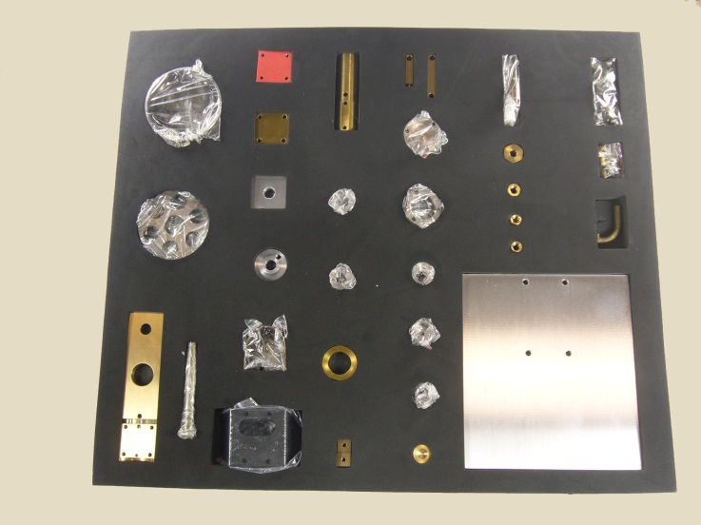
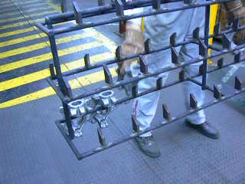
Kit Building
Process in which individually separate but related items are grouped, packaged, and supplied together as one unit
Utilized in many manufacturing assembly lines
Robotic solution requires:
Flexibility –Many parts with varying characteristics, part-to-part inconsistences
Agility – Changes in part supply locations, lack of fixturing
Rapid re-tasking – Ability to quickly build new varieties of kits

Slide 3
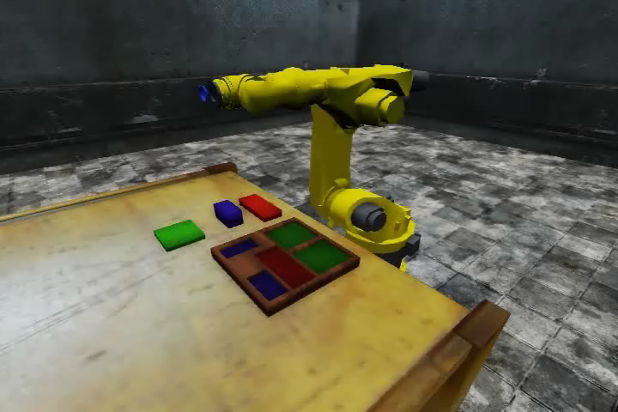
Real Planning / Simulated Robot
Video is 2x real time

Slide 4
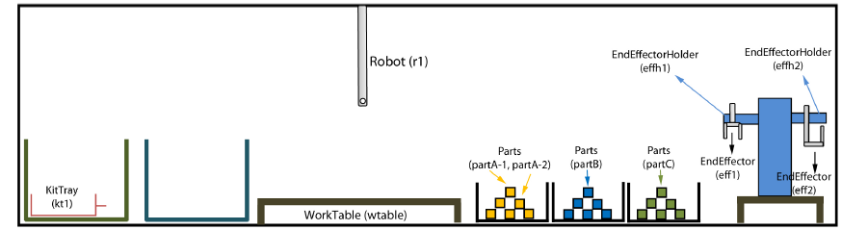
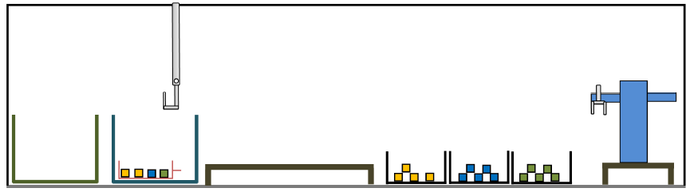
Planning Problem
Ƥ = (Ʃ, s₀, g)
Ʃ - State transition system (possible actions)
S₀ - Initial conditions (objects and relationships)
g – Goal conditions
Initial Condition
We would like to examine the knowledge requirements of this planning problem
Goal Condition

Slide 5
Underlying Knowledge Representation
Objects
What objects and attributes are relevant
Taxonomy of objects
Relationships between objects
Actions
What actions and attributes are relevant
Necessary conditions for an action to occur
Likely results of the action
Dynamic world
Object attributes change over time
Actions do not always accomplish what we want them to

Slide 6
Objects, Relationships, and Actions
State-Variable Representation¹ (SVR) used to formally define environment’s objects, object relations (state), and actions
Each state is represented by a tuple of values of n state variables {x₁,…, x_{n}}
Action is represented by a partial function that maps this tuple into some other tuple of values of the n state variables
SVR is not a standard interchange language
Can encode the SVR into Planning Domain Definition Language (PDDL)
¹Dana Nau, Malik Ghallab, and Paolo Traverso. 2004. Automated Planning: Theory & Practice. Morgan Kaufmann Publishers Inc.

Slide 7
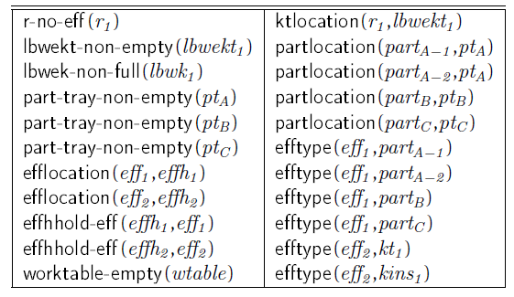
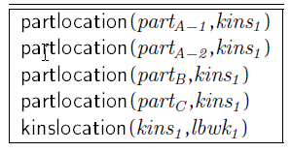
Planning Domain Definition Language (PDDL)
Initial Condition
Initial Condition encoded as set of predicate expressions
Goal Condition encoded as set of predicate expressions
Plan and actions are necessary to move from initial predicates to goal predicates
Goal Condition

Slide 8
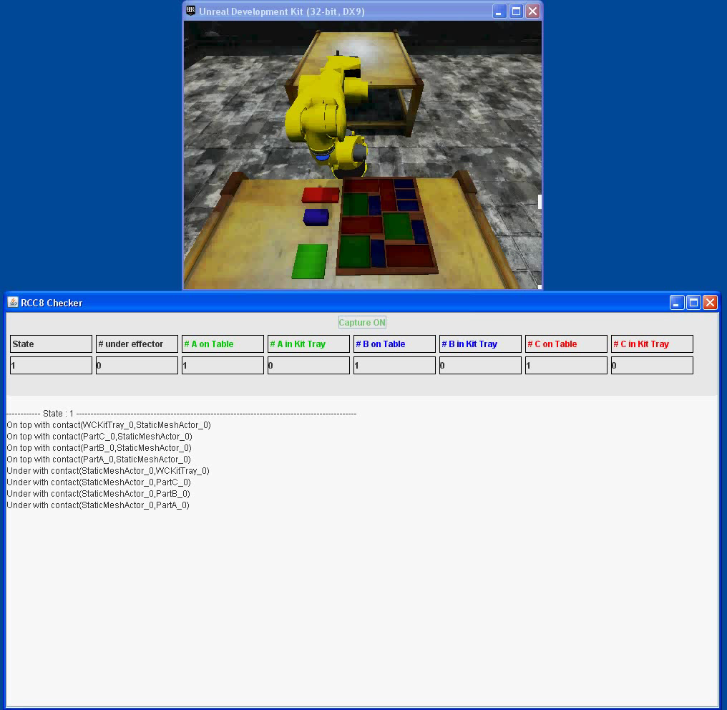
Auto-Determination of Predicates
Sensor processing simulated from ground truth
Each table line is new system state (set of predicates)
Each table column is “watched” predicate
Bottom area shows state deltas

Slide 9
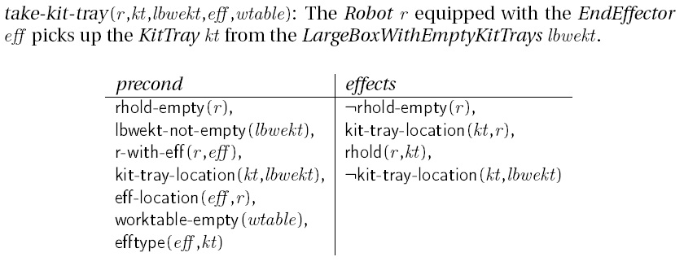
Planning Domain Definition Language (PDDL)
Entire kitting domain composed of:
28 predicate expressions that act as preconditions or are acted upon during effects: rhold-empty, r-with-eff, kit-tray-location, worktable-empty, …
9 high-level operators (actions): take-kit-tray, put-kit-tray, take-kit, put-kit, take-part, put-part, attach-eff, remove-eff, create-kit

Slide 10
Implementation of PDDL Actions
Interface to many simulated and real robots
Provide lowest common denominator actions for robot execution
Move
Open/Close Gripper
…
PDDL actions implemented as scripted sequence of these actions (called the Canonical Robot Command Language)

Slide 11
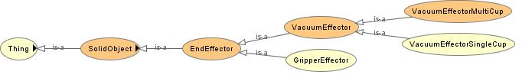
SVR - PDDL Limitations
Planning language not designed for knowledge representation
Lacks a taxonomy of objects
No representation of relationships or constraints between objects
An ontology provides for all of the above through entities, data properties, and object properties
Web Ontology Language (OWL) can be used to represent objects, relationships, and constraints
OWL Services (OWL-S) and the Semantic Web Rule Language (SWRL) can be used to represent actions, preconditions, and effects
Tools exist to move from OWL and OWL-S/SWRL to PDDL representations
Example Class Hierarchy

Slide 12
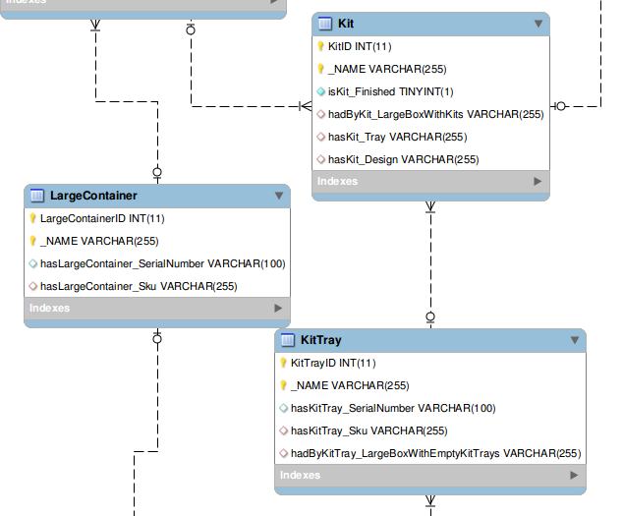
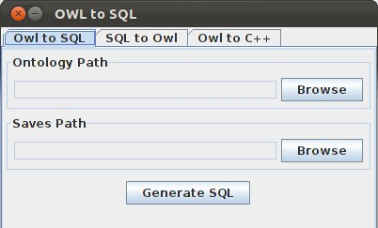
Issues With Dynamics
PDDL/OWL representation is a set of static files with no real-time information
Can auto-generate MySQL database from OWL instance file and maintain database with sensor processing (access functions also auto-generated)
Can automatically re-generate OWL instance file to allow for continued reasoning
Image from mysql-workbench

Slide 13
Knowledge Generation
System Execution
Auto-gen
MySQL database, PDDL plan file
Auto-gen
PDDL Domain, Problem files
Hand created
OWL-S, SWRL Rule files
Hand created
OWL Model, Initial Condition, Goal Condition files

Slide 14
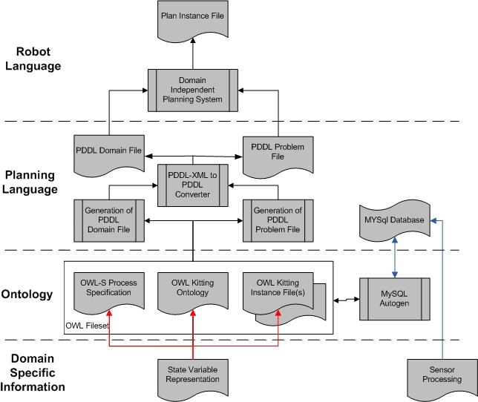
Knowledge Architecture

Slide 15
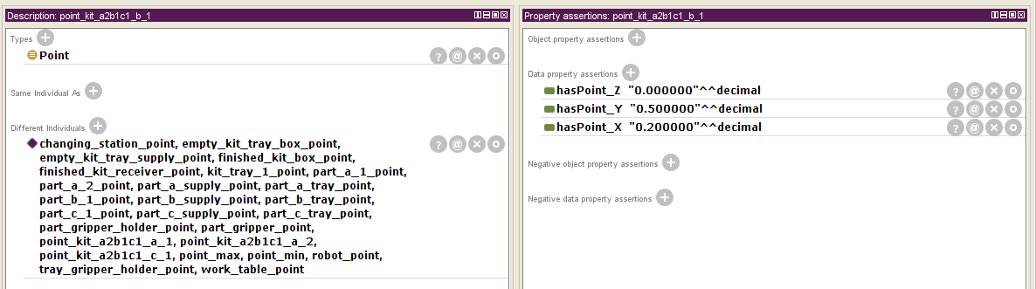
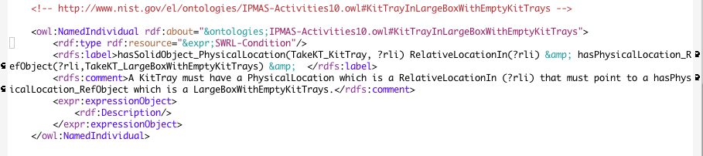
Implementation Issues: OWL/OWL-S
Naïve user, but…
SWRL Rules
Very verbose data entry for rule, pre-conditions, and effects
Difficult/impossible to represent negation
OWL Instance Modification
Open world assumption allows spelling errors
Required to typecast every data entry
Need to follow complex trail of tables and pointers
Removal of instance requires careful clean-up to remove “hanging” entries
Is there another way?
Investigated use of XML and PDDL with automatic generation of OWL files

Slide 16
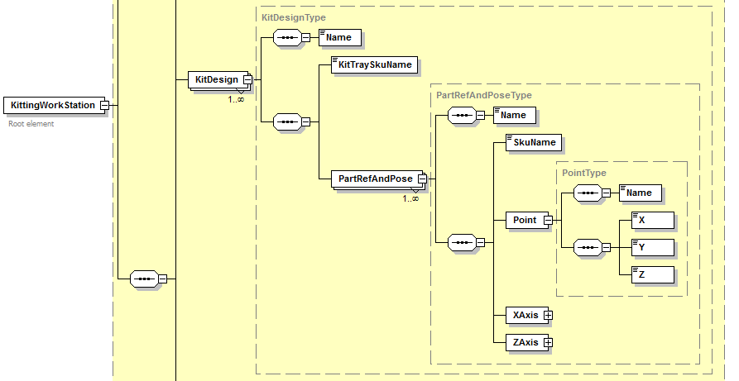
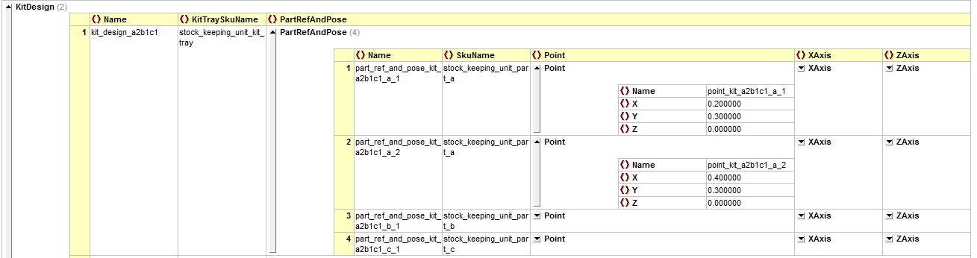
XML Representation
Schema view clearly shows elements, element structure and properties, and classes
Able to see all relevant, strictly typecast fields for data entry

Slide 17
More Tools
We have created XML->OWL conversion tools
Can automatically generate an OWL “instance” file from an XML file
Work currently underway to generate OWL “model” file from XML schema
XML provides
Closed world assumption
Type checking
Consistency checking

Slide 18
System Alternatives?
System Execution
System Execution
Auto-gen
MySQL database, PDDL plan file
MySQL database, PDDL plan file
Auto-gen
OWL Model, Initial-, Goal-Condition files, PDDL Problem file
PDDL Domain, Problem files
Hand created
PDDL Domain file, code for predicate generation
OWL-S, SWRL Rule files
Hand created
XML Schema, Initial Condition, Goal Condition files
OWL Model, Initial Condition, Goal Condition files

Slide 19
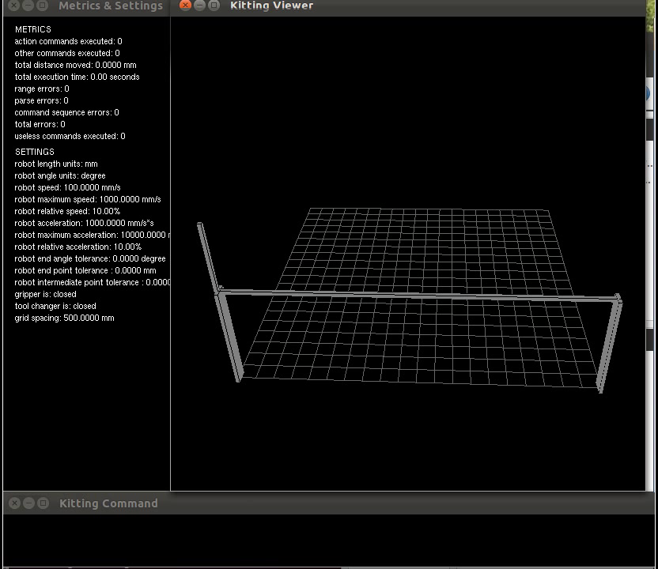
Future Work, Metrics
Time to build
Distance robot traveled
Number of actions
Useless commands
Errors
…

Slide 20
Future Work
Current work assumes perfect actions; need techniques to gracefully cope with errors
Migrate techniques onto real hardware with real image processing
Extend work to apply to general assembly operations
Develop metrics for kit building

